Slide 1
SOLAR POWERED AUTONOMOUS MULTIPURPOSE AGRICULTURAL ROBOT USING BLUETOOTH
Guide:
Dr.B.Sridhar
BY
Gumpa Sireesha
17R21A04D8
B. Ruchitha Reddy
17R21A04G5
Sirikonda Nikitha
17R21A04H3
Paidimalla Shivani
18R25A0431

Slide 2
INTRODUCTION :
India nearly about 70 percentages of people are depending on agriculture. Numerous operations are performed in the agricultural field like seed sowing, grass cutting, plugging etc. The present methods of seed sowing, pesticide spraying and grass cutting are difficult. The equipment's used for above actions are expensive and inconvenient to handle. So the agricultural system in India should be encouraged by developing a system which will reduce the man power and time. This work aims to design, develop and design of the robot which can sow the seeds, cut the grass and spray the pesticides, this whole system is powered by solar energy. The designed robot gets energy from solar panel and is operated using Bluetooth/Android App which sends the signals to the robot for required mechanisms and movement of the robot. This increases the efficiency of seed sowing, pesticide spraying and grass cutting and also reduces the problem encountered in manual planting.

Slide 3
EXISTING SYSTEM:
The existing system has no only robot which is controlled with Bluetooth and android app but there is no interfacing of different sensors like soil sensor. And it doesn’t have any rechargeable battery.

Slide 4
PROPOSED SYSTEM:
The proposed system consist of microcontroller which is controller for the whole system as and solar panel is connected to the battery for storing energy and further it is given to power supply charging circuitry which is providing +5 V for the microcontroller and +12 V supply for driving DC motors using L298 motor driver module. Bluetooth HC05 is connected with microcontroller and wirelessly with Android Smartphone to controlling the whole system.

Slide 5
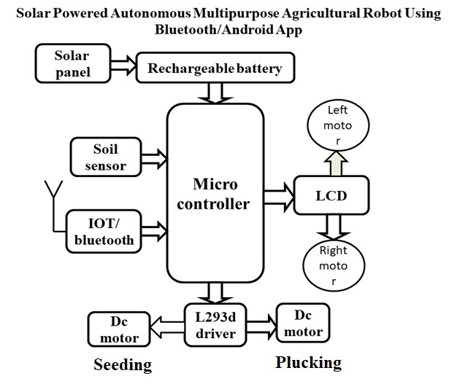
BLOCK DIAGRAM:

Slide 6
HARDWARE REQUIREMENTS:
Regulated power supply (RPS)
Microcontroller.
Soil sensor.
LCD.
Bluetooth
Motor driver.
Dc motors.
IOT module.

Slide 7
SOFTWARE REQUIREMENTS:
Embedded C

Slide 8
ADVANTAGES:
This increases the efficiency of seed sowing, pesticide spraying and grass cutting.
And also reduces the problem encountered in manual planting.
No need of man power.

Slide 9
DISADVANTAGES:
System with high cost and high complexity.
Breaking queues.
Power issue

Slide 10
SWOT ANALYSIS:
STRENGTH | WEAKNESS | OPPORTUNITY | THREAT
High Efficiency | High cost and complexity | Agricultural Sector | Damage to device may lead to wrong operation.
No need of man power | Power issue | Local farming | Power problem may arise due to absence of sun for a long duration .

Slide 11











THANK YOU

